Slide 1
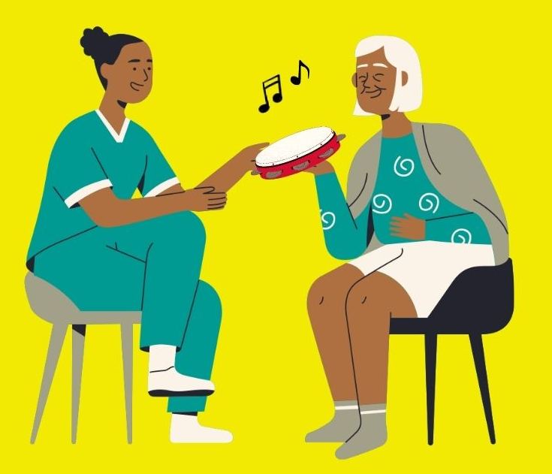
Music in Mind
Music Making Activity Ideas

Slide 2
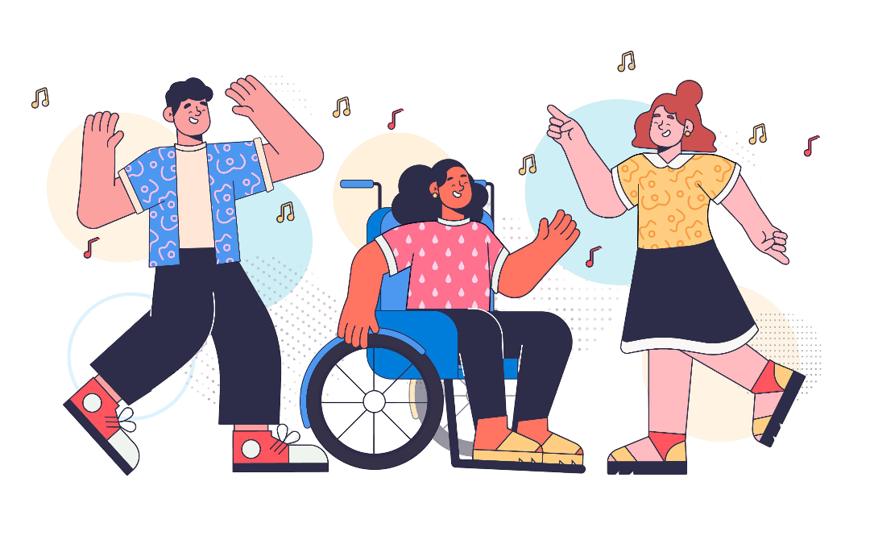
Warm-up Games for Music Champions

Slide 3

Rhythm Game 1 – Forbidden Rhythm
Activity:
This is a musical version of ‘Simon Says’. Pick a leader, and the rest of group follows.
The leader will clap a 4-beat rhythm, and the group will clap it back.
If the leader claps the forbidden rhythm (sounds like the syllables in the phrase ‘don’t clap this one back’), then the group stays quiet.
Extension:
Try using different forbidden rhythms, making it harder to remember! Alternate using clapping, stamping and other actions to demonstrate your rhythms.
Pick some different rhythms with associated responses (e.g., a specific rhythm to put your hands in the air, one to spin around, or shout ‘hey!), get creative!
Reflection:
What made this activity challenging? What do you think helped make it easier?

Slide 4
Rhythm Game 2 – Keep the Beat
Activity:
Sit or stand in a circle. Nominate one person to stamp their foot to help maintain the beat. Take turns clapping in sequence around the circle to keep a steady beat.
If this is tricky, you can use a metronome video on YouTube to help. Try anything from 60-100bpm to vary the speed.
Extension:
Gradually speed up or slow down the beat, being careful to follow the person who is stamping.
Try keeping the beat with the percussion instruments, switching directions, skipping people or adding rests for extra challenge.
Reflection:
What techniques did you find useful to keep everyone on track?

Slide 5
Rhythm Game 3 – Clap that Tune
Activity:
Choose a familiar song. Everyone claps one syllable of the song’s lyrics in sequence around the circle. Try to maintain the rhythm smoothly as the clapping moves from person to person.
Song suggestions: ‘Daisy, Daisy’, ‘Happy Birthday’, ‘Oh When the Saints’.
Extension:
Each person sings one syllable of the song instead of clapping.
Send one person out of the room so they do not know the song. The group claps the song as before, and the returner tries to guess the song the group have chosen.
Reflection:
What did you notice about group dynamics when the rhythm sped up or slowed down?

Slide 6
Rhythm Game 4 – 1-10
Activity:
The aim is to count from 1-10 together using voices, claps or percussion. Everyone must say or play exactly one number before anyone can say a second number.
No planning allowed, numbers are said spontaneously in turn. If two people say the same number at the same time or any number is repeated, the group goes back to 0 and starts over.
Extension:
Attribute a specific sound, instrument or action to each number. Increase the range beyond 10 or shorten the time allowed between numbers.
Can you do it with your eyes closed? Or within a certain time limit?
Reflection:
What cues or signals might be useful to aid group communication without words?

Slide 7
Breathing Exercises
Activity
Take 5-10 intentional deep breaths, breathing in through your nose, and out through your mouth.
Variations:
Inhale while raising arms, exhale while lowering slowly.
Try making your exhale longer each time.
Breathe in for 4 beats, hold for 4 beats, out for 6 beats.
Add humming, blowing or vocal sounds on the exhale.
Reflection:
How might this exercise help prepare a group to make music together?

Slide 8
Vocal Game 1 – Conductor
Activity:
Choose one person to be the conductor. The conductor will use hand signals to guide the group, and the challenge is to influence the group sound. Some examples could be:
  Pitch – Move hand higher/lower to indicate making your voice higher or lower.
  Volume - Make big, wide gestures to indicate louder volume, or smaller, contained actions for quieter.
  Timbre – Indicate vowel sounds for the group to copy using your mouth or hands.
Extension:
Try using two conductors guiding different halves of the group – see how two sets of voices blend and contrast.
Could you get rid of the hand signals? Everyone must listen and copy the leader’s voice.
  Turn this into a ‘wink murder’ style game. Send someone out, and on their return, they must listen and guess who the conductor is.
Reflection:
How did being a conductor or a group member change your awareness of listening, leading and following.

Slide 9
Vocal Game 2 – 121
Activity:
Firstly, make sure you have a full set of bells. Line these up lowest to highest (they’re numbered!)
Someone will play the first bell, and everyone sings ‘one’ at the same time and pitch as the bell. Slowly build the pattern both playing and singing the notes – 1, 121, 12321, 123432… etc. until you have played all the bells.
Extension:
Try speeding up! Also – play around with dynamics, singing softly or loudly.
Can you reverse the pattern, starting with bell 8?
Turn this into an echo game, where one person plays a short bell sequence, and the group have to sing it back to them using the note numbers or names.
Reflection:
What did you notice about group listening and coordination?

Slide 10
Building Track Familiarity
Activity:
Each week, pick a different Music in Mind track. Listen as a group and play along using the instruments as if it were part of a Music Café session.
Afterwards, reflect as a group on both the tracks and the experience. Have a think and put together some of your own suggestions for instruments, ideas and activities which may work well with each track.
Extension:
Try the track with different instrument types and groups (i.e. just bells, just drums, etc) and experiment with how this changes things – what works, what doesn’t?
Reflection:
Could you identify any key moments within the tracks (for example, are there lots of repeats?)
Can you think about when and why you may use the track, and how you might keep it varied?

Slide 11
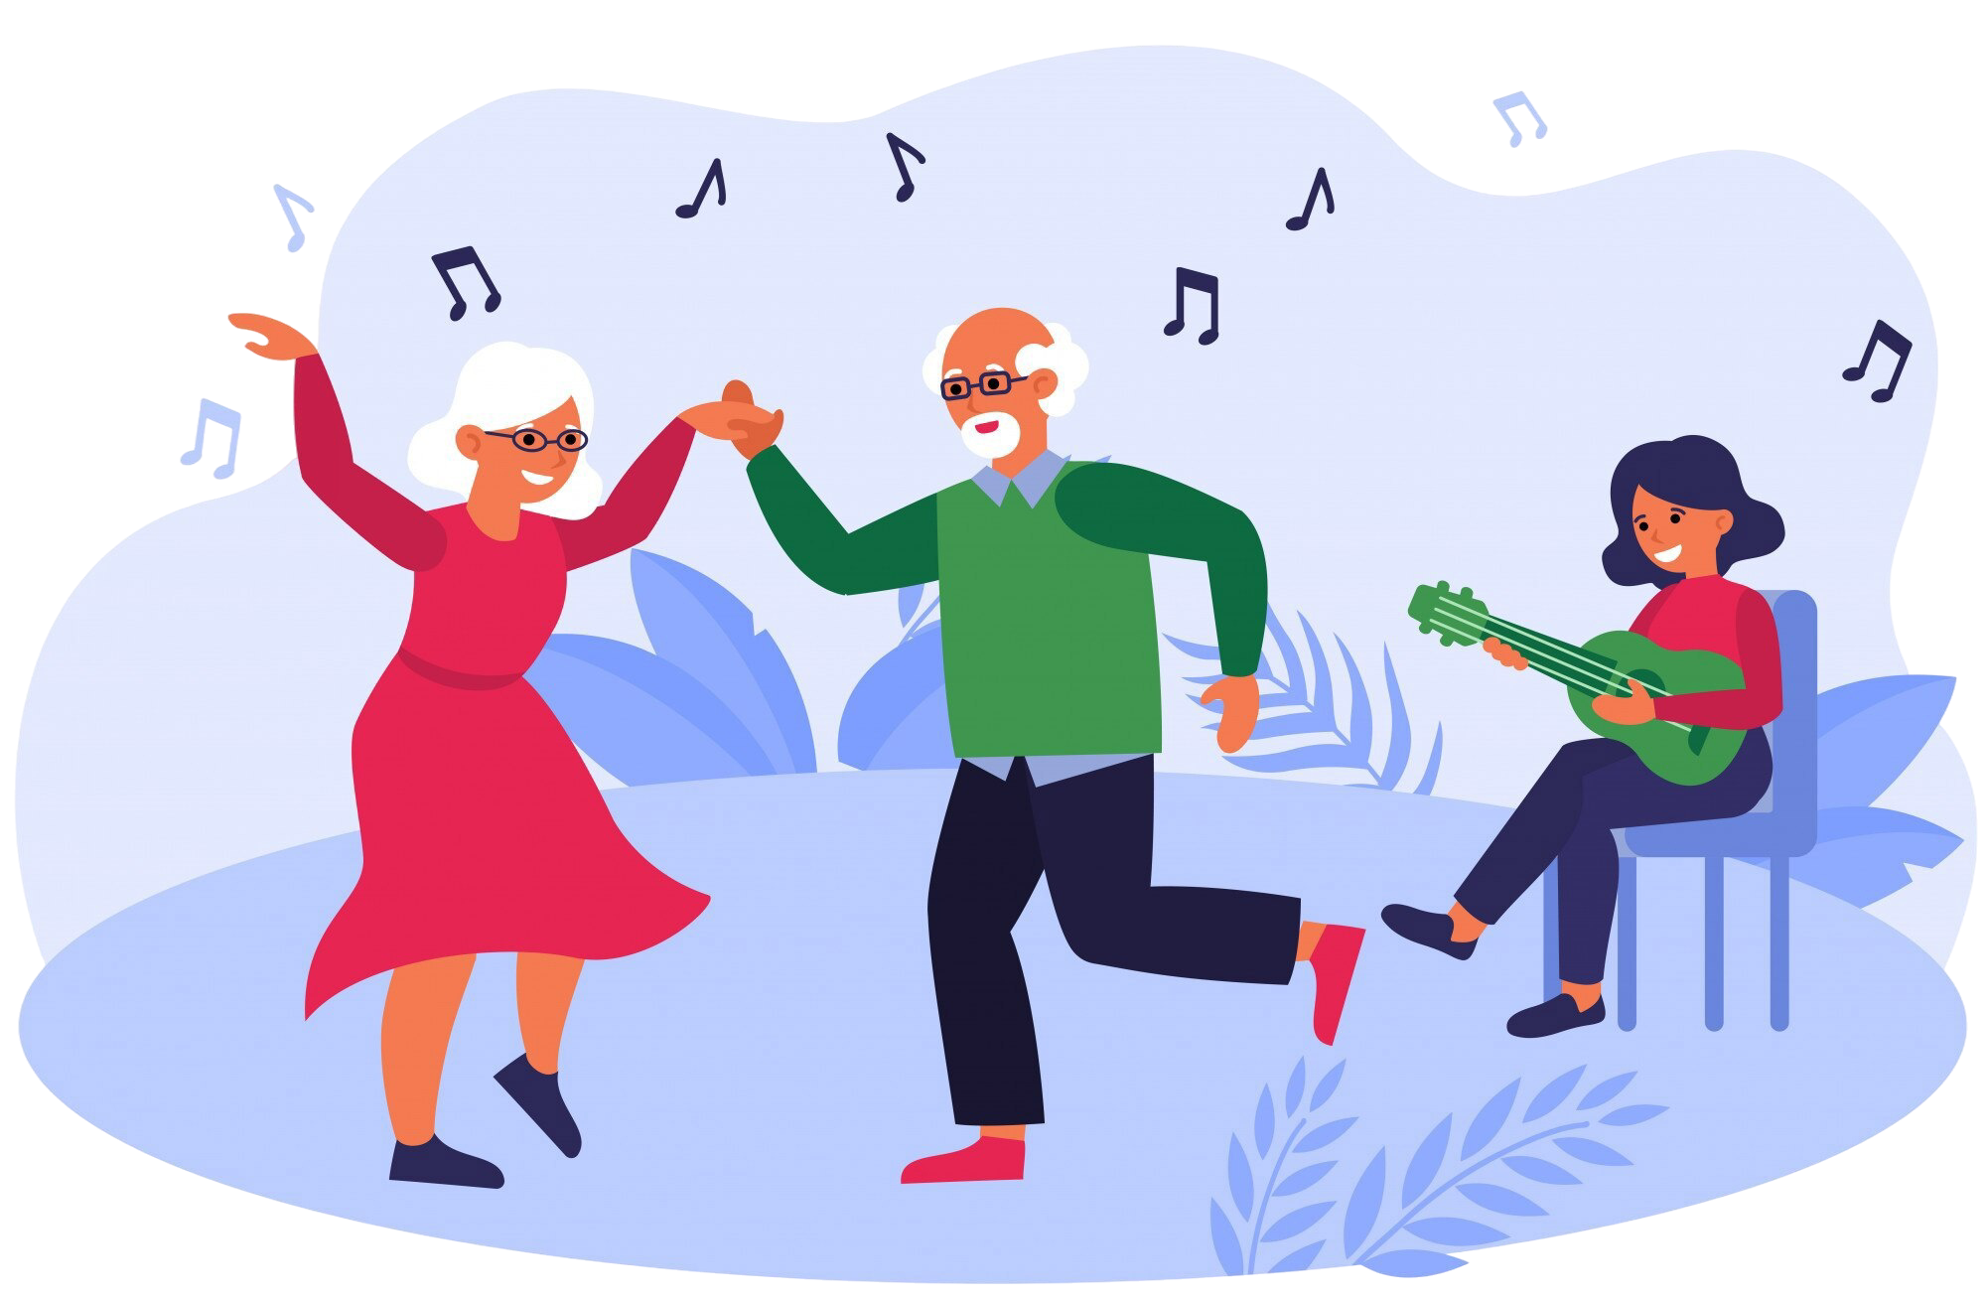
Session Activity Ideas

Slide 12
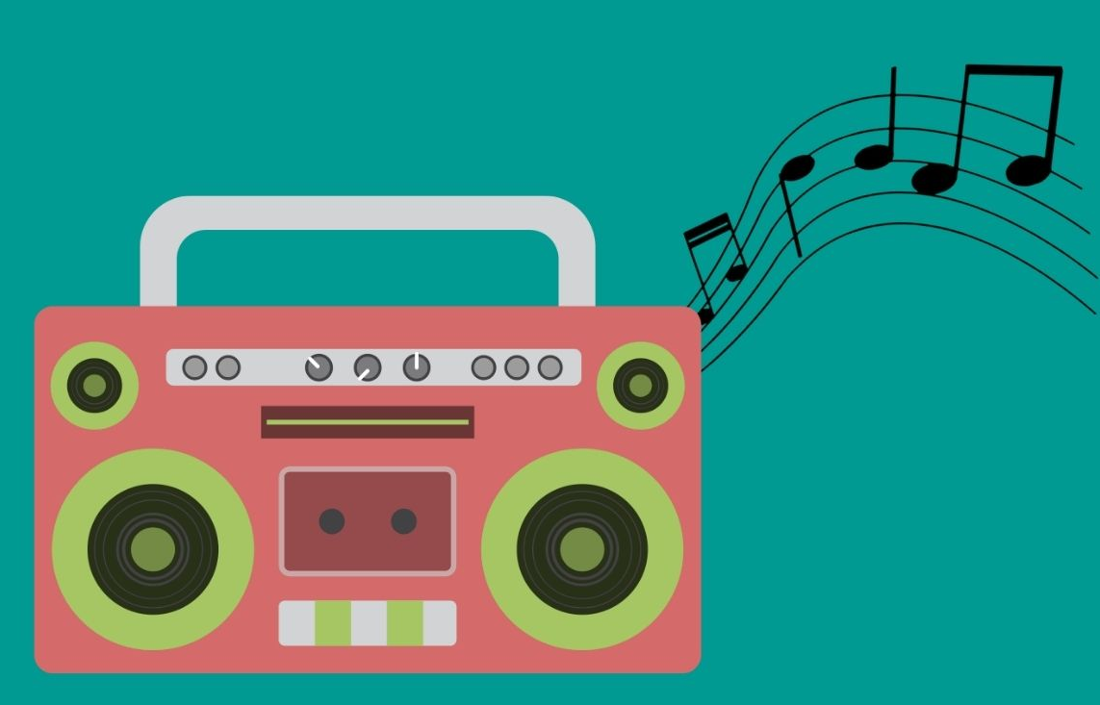
Using the Music in Mind Tracks

Slide 13
Blues
Instruments:
Fingers and brushes on drums
Handbells (D&G)
Shakers
Cymbal
Movement:
Swaying
Shimmying shoulders
Figure of 8 with arms and hands
Musical Activities:
Emphasise the off-beat (beats 2&4) with a vocal ‘ch’ or shaker sound
Count the 8 beats with the group, and all play on a number/numbers of your choice.
Come up with rhythms of your own, e.g. -

Slide 14
Jig
Instruments:
Drums
Voice/Humming
Body Percussion
Hand bells
Castanets
Movement:
‘Galloping horse’ rhythm on knees (ba-dum)
Kicking legs left-right
Dancing
Musical Activities:
‘One for me, one for you’ – in pairs, take it in turns to play one note each on a shared instrument, for example on the 1st and 4th beat.
Descending handbells – C8-B7-A6-G5-F4-E3-D2-C1

Slide 15
La Bamba
Instruments:
Egg Shakers
Maracas
Body percussion (tapping knees)
Claves (wooden sticks)
Guiro (scraper)
Movement:
Body percussion – knees and toes tapping
Shoulder shaking/shimmy
Musical Activities:
‘One for me, one for you’ – in pairs, take it in turns to play one note each on a shared instrument. Pass an egg shaker around the room and spotlight whoever is holding it.

Slide 16
March
Instruments:
Voice/Whistling
Drums
Body percussion (stamps and claps)
Cymbal
Movement:
Left-right (can be sitting in chair, marching on the spot or round the circle)
Clap on the beat
Musical Activities:
Whistle or sing ‘Colonel Bogey’ tune.
Share a cymbal or drum around the group and make rhythms in turn. Allow everyone to have a beater and use large gestures to encourage everyone to have a go. Are there any patterns emerging?

Slide 17
Rock ‘n’ Roll
Instruments:
Drums
Voice
Claves
Body percussion
Jingle bells (at Christmas)
Movement:
All hold hands. Move hands in/out, or up/down on the beat.
Hand jive
Musical Activities:
Half of the participants have wood instruments; the other half have drums. Alternate to build ‘oom-cha’ rhythms.
Create song ‘Look at [name] doing/playing/moving…’, e.g. ‘look at Margaret playing the drum!’ Go around each participant in turn.

Slide 18
Shakey Shakes
Instruments:
Shakers only!
Movement:
Shaking – hands, feet, arms, shoulders - whatever works!
Musical Activities:
Musical statues activity, sing lyrics while moving and playing shakers – ‘shakey shakey shakey shakey shake shake shake x3, shakey shake shake and STOP!’
Repeat until participants get the hang of it – this may need to go way beyond the end of the track.

Slide 19
Sway
Instruments:
Claves
Guiro/scraper
Castanets
Glockenspiel/Chime bars
Hand bells
Movement:
Shoulder sways
Body percussion
Reaching up or to the sides
Musical Activities:
Alternate notes A and D in time with the music on bells and chime bars (they’re all labelled and colour-coordinated). Follow the pattern: A 2,3,4, D 2,3,4.
Freestyle in the middle section.

Slide 20
Tea for Two
Instruments:
Gong
Triangle
Hand bells (C&E)
Cymbal
Tambourines
Movement:
Dancing – Swinging, arms, swaying
Getting up and dancing round circle (if they are able)
Musical Activities:
This track is especially useful to encourage solos and spotlighting as it is quiet and leaves big gaps. Use gestures to encourage participants to fill the musical gaps.
Sing the melody without lyrics.

Slide 21
Waltz
Instruments:
Chime bars
Hand bells (D,E,G,A,B)
Voice and humming
Movement:
Swaying and swinging arms
Get up and waltz together (if they are able)
Musical Activities:
Hum or sing the tune, encouraging participants to join in. Using voices, as well as hand bells/chime bars, make up your own melody.

Slide 22
Zum Gali
Instruments:
One group leader has a tambourine
Body percussion
Movement:
Two claps, tapping feet
Musical Activities:
Group leader moves around the circle offering the tambourine to each participant in the musical gaps. Model the response using voice (‘pom pom’ etc.), with large gestures or supporting by demonstrating tapping the tambourine.

Slide 23
Wistful
Instruments:
Brushes on drums
Rain sticks
Chimes
Movement:
Swaying
Moving using scarves/bits of fabric
Musical Activities:
This track is ideal for the quieter, more reflective moments. Model quieter and relaxing instruments. If you have them available, wafting scarves and fabric can be really effective.

Slide 24
Glenn Miller
Instruments:
Shakers
Guiro/scraper
Tambourines
Body percussion (clapping and tapping feet)
Movement:
Hand gestures – jazz hands
Kicking feet – chair Charleston
Musical Activities:
Encourage a call and response through hand gestures (to me, to you). Use the musical gaps and the track to encourage a group shout at the key moments in the track.

Slide 25
Squat Dance
Instruments:
Shakers
Tambourines
Cabasas
Scrapers (guiro)
Claves
Movement:
Clicking fingers and moving arm side to side
Kicking legs left and right
Musical Activities:
This track is great to encourage group movement. Try different options – all kicking left to right and waving hands. Link arms and sway side to side, shouting ‘hey!’

Slide 26
Bossa Nova
Instruments:
Castanets
Large drums/Djembe
Cajon
Claves
Egg shakers
Movement:
Dancing
Moving left/right
Musical Activities:
Try and start up a musical conversation across the room – use castanets to mimic chatting and use large gestures to mirror someone of your choice. Be playful with it! Encourage the group to come together in call and response, or stopping together.

Slide 27
Drone
Instruments:
Bells
Vocals
Ocean drums
Any instruments!
Movement:
Swaying, tapping toes.
This track is really open, so whichever movements reflect the music made!
Musical Activities:
Try and encourage people to vocalise and sing or hum. Mirror controlled breathing and blowing – this track can be quite meditative.

Slide 28
Sound Worlds
Instruments:
Any and all!
Movement:
Swaying
Dancing
Waving arms, kicking legs
Musical Activities:
These tracks are completely open and designed as a musical safety net or backing for free improvisation. Feel free to experiment, observing the different roles taken by members of the group

Slide 29
Reggae
Instruments:
Shakers
Body percussion
Drums – djembes and cajon
Movement:
Swaying
Rocking shoulders back and forth
Clicking
Musical Activities:
Add words spoken rhythmically over the beat – this could be anything relevant to the group! Try and make it call and response, or add claps on beats 2&4.

Slide 30
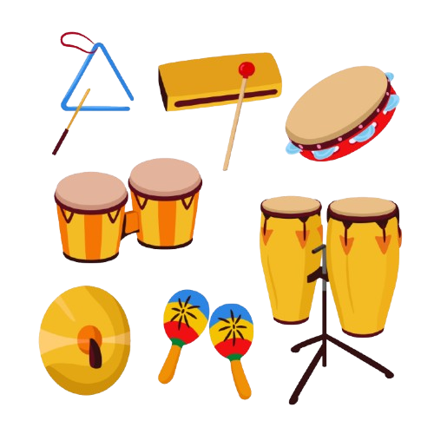
Flexible Musical Activity Ideas

Slide 31
Whole Group Ideas
One instrument for the whole group:
Pick one instrument and travel round the group offering it to participants, similarly to in Zum Gali. Enccourage them to play it briefly before moving on and offering to someone else. Mirror the mood of the music in your movements.
Song Suggestions:
It’s not Unusual
Jailhouse Rock
Teamwork – oom-cha:
Split the group into two. You can also vary instruments (e.g. one half with wooden, the other with metal). Each half takes turns playing a beat to create a consistent alternating “oom-cha” rhythm.
Song Suggestions:
Sugar, Sugar
You Can’t Hurry Love

Slide 32
Whole Group Ideas
Pass the instrument:
Use one shared instrument and pass it round , encouraging participants to play and then pass it on. Feel free to add multiple instruments. If it helps, use a specific phrase or moment in the song to indicate passing on the instrument.
Song Suggestions:
I Can’t Get No Satisfaction
Help!
Call and Response
Everyone gets a rhythm instrument. The leader should have a more dominant instrument. The leader plays a short pattern, and the group copies. Try and keep it varied and encourage different participants to lead.
Song Suggestions:
Twist and Shout
Hit the Road, Jack

Slide 33
Whole Group Ideas
Humming:
Encourage participants to put down their instruments and join in, humming or vocalizing (they don’t have to sing the words, ‘de-dum’ or ‘la la la’ work perfectly). Model swaying or gentle movement.
Song Suggestions:
You are my Sunshine
Que Sera, Sera
One for Me, One for You:
Have one instrument between two and encourage participant to alternate playing one or a couple of beats, before swapping over. They might play the same patterns, alternate or experiment freely.
Song Suggestions:
Ob-La-Di
Rock Around the Clock
This Little Light of Mine

Slide 34
Familiar Music Ideas: Movement
Stamp Stamp Clap:
You can vary this, for example ‘left, right, hey!’ or ‘tap, tap, click’ using different instruments and body percussion
Suggested Songs:
We Will Rock You
Pretty Woman
Please Mr Postman
Swaying:
Encourage the group to sway or shimmy their shoulders. Can you coordinate everyone? Invite participants to place their hands on neighbours’ shoulders and work in a circle.
Suggested Songs:
It’s in his Kiss
Build me up Buttercup
Two Claps/Nods/Stamps:
This is a nice exercise to bring the group together. Use big gestures and adapt for group ability – stamp left right, click to either side or double clap above your head.
Suggested Songs:
Jailhouse Rock
These Boots are Made for Walking

Slide 35
Hand Bell Ideas
Somewhere Over the Rainbow:
Pass out the bells ordered like so: C/8 B/7 A/6 G/5 F/4 E/3 D/2 C/1. Point to each participant to ding their bell in time.
C Somewhere
B Over the rainbow
A Way up
G High
F There's a
E land that I heard of
D Once in a lulla
C by
Do-Re-Mi:
Now, you can use the bells in reverse to sing ‘Do-Re-Mi’:
C/1 Do, a deer, a female deer
D/2 Re, a drop of golden sun
E/3 Mi, a name, I call myself
F/4 Fa, a long, long way to run
G/5 So, a needle pulling thread
A/6 La, a note to follow So
B/7 Ti, a drink with jam and bread
C/8 That will bring us back to
C/1 Do, oh, oh, oh

